Slide 1

User Manual LAN App

Slide 2
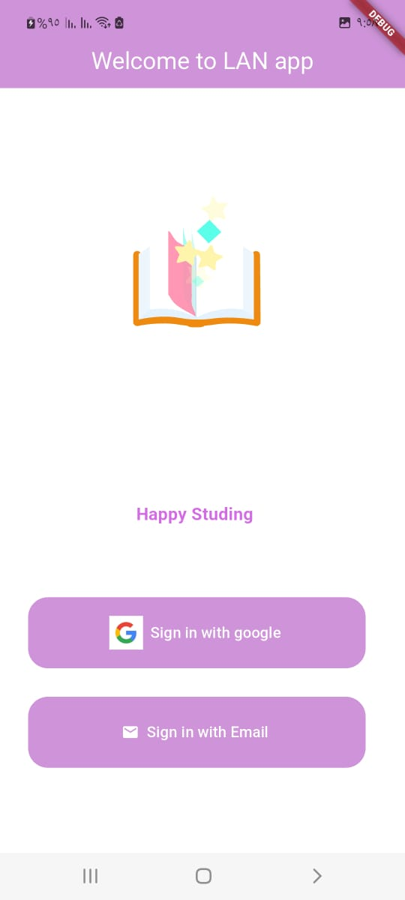
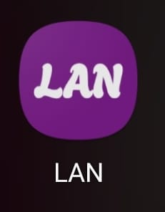
This is the App Icon :
When you click on it, the Splash screen appears, then Welcome screen
You can sign in using Google account or email

Slide 3
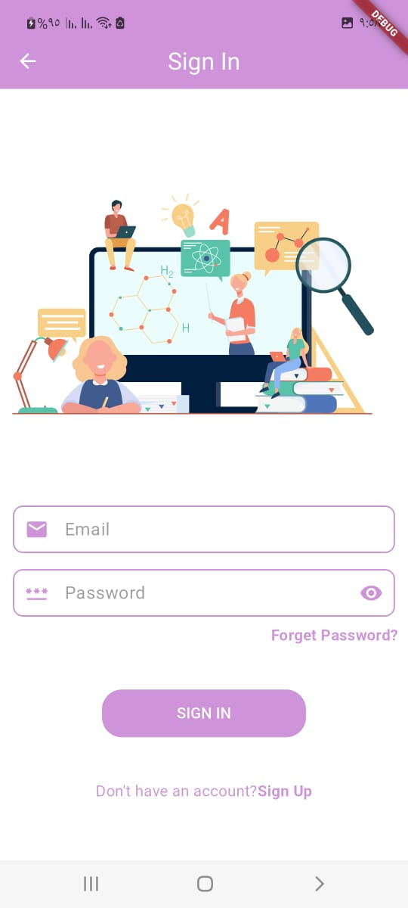
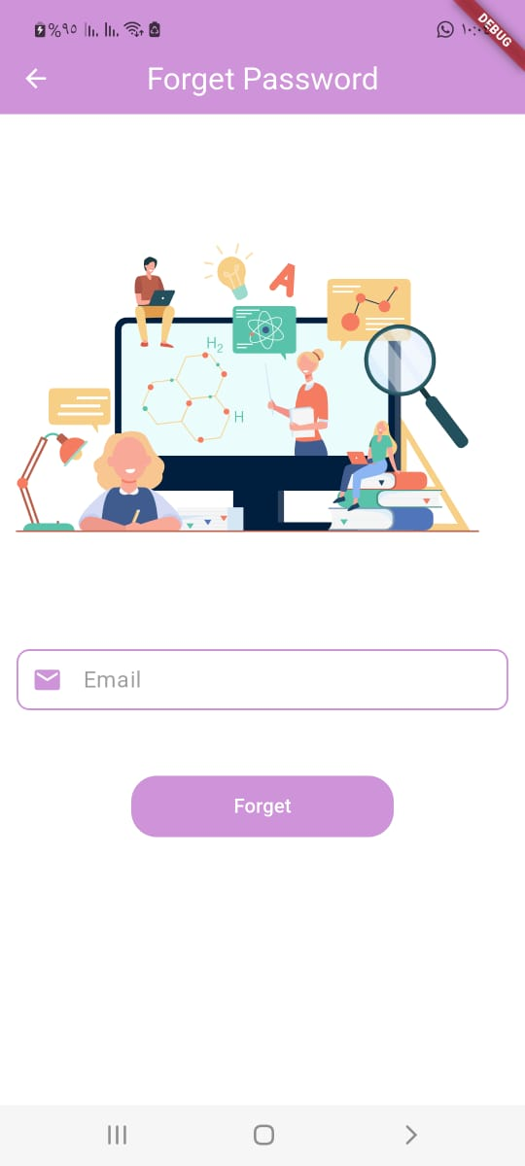
When click to sign in with email show this:
It can be used if you already have an account. If you forgot your password , you can click here ,
Then this screen will appear :
Then you will receive email to reset your pass in your email

Slide 4
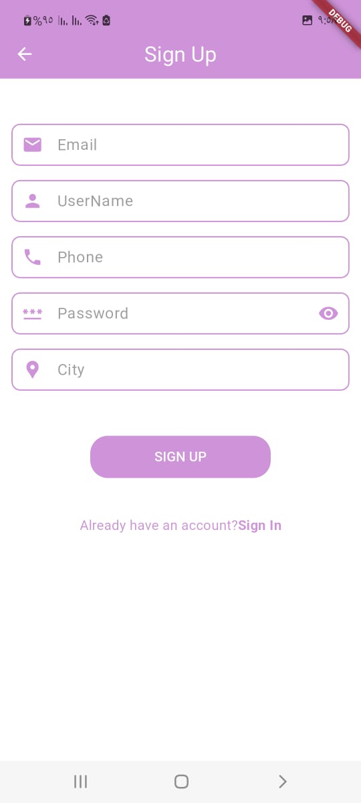
If you don’t have an account , you can sign up

Slide 5
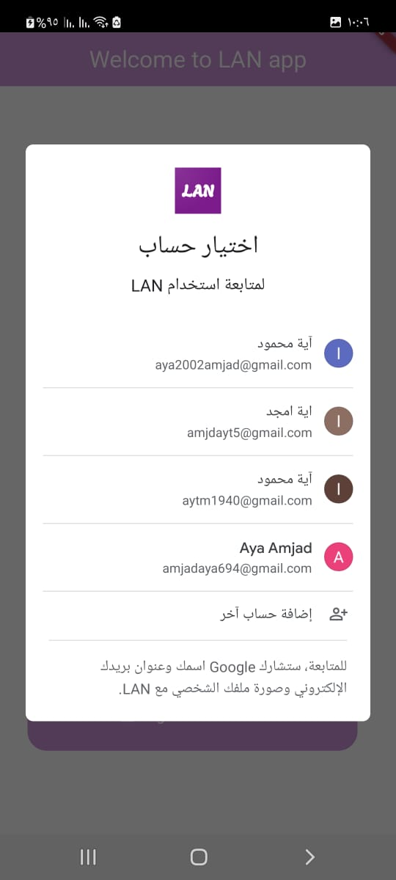
If you need sign in using google an account

Slide 6
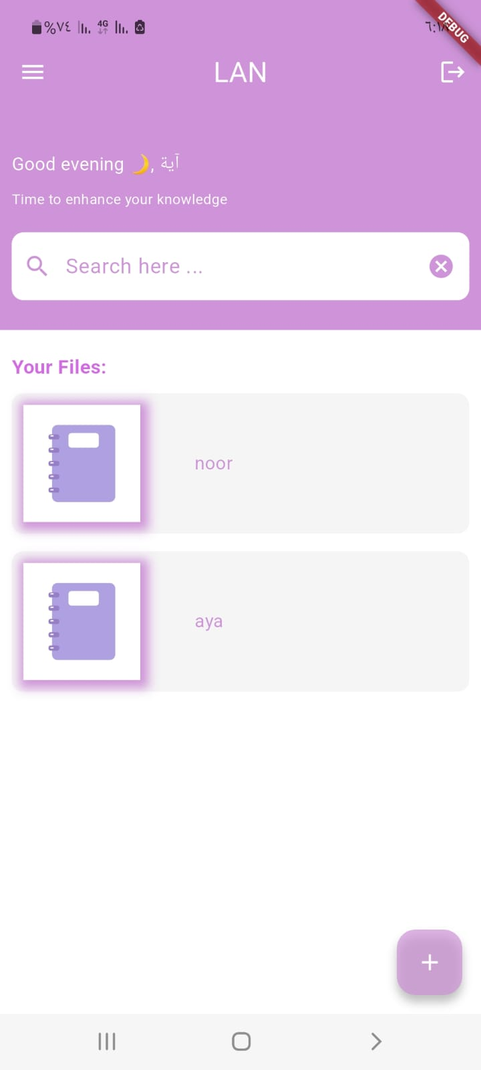
After login to app, appear main screen :
Welcome to the user
To search for a file using its name
Displays all files uploaded by the user
To add new file

Slide 7
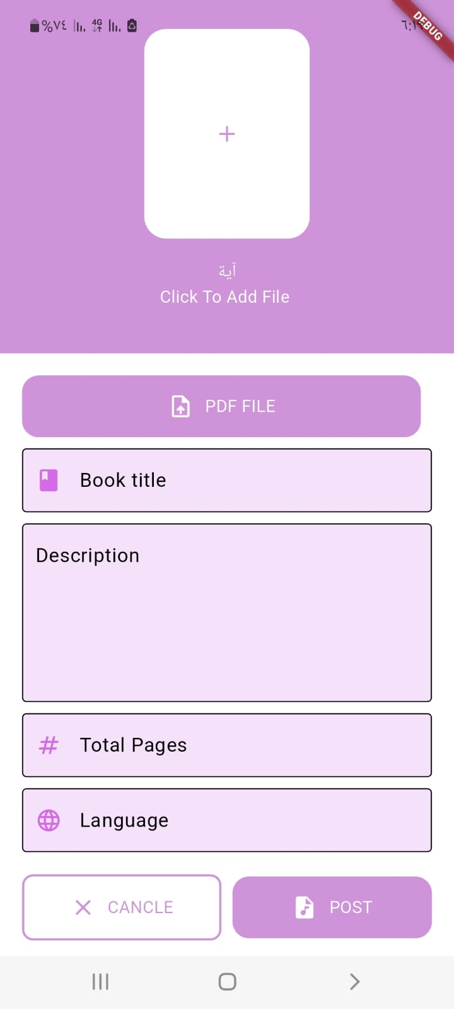
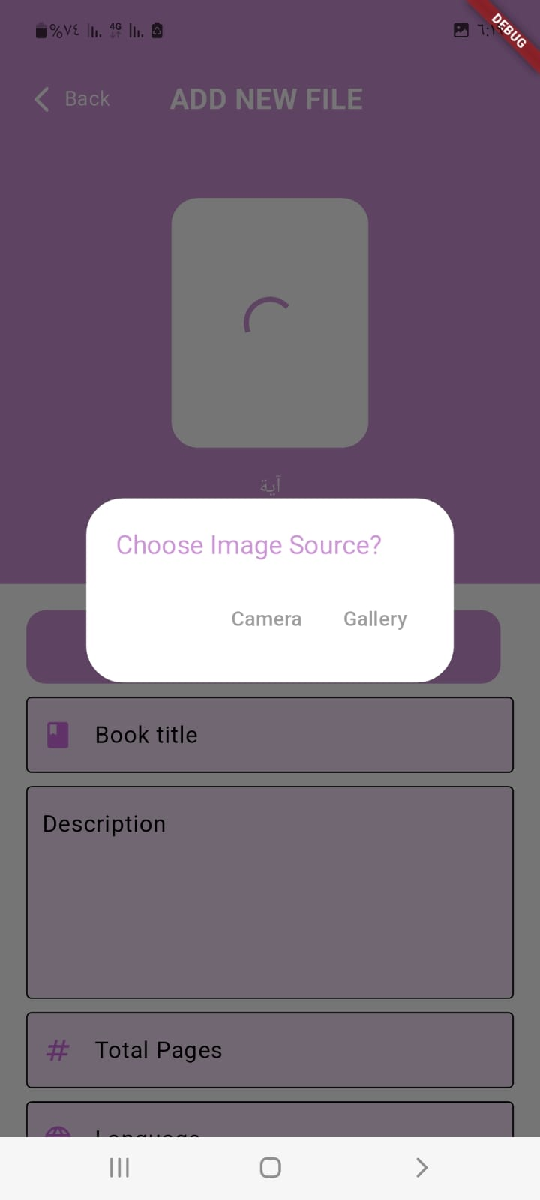
Screen Add file
You can choose
file cover
image source
You can upload file cover
if user does not choose an image , the app show default image
Upload file and all details

Slide 8
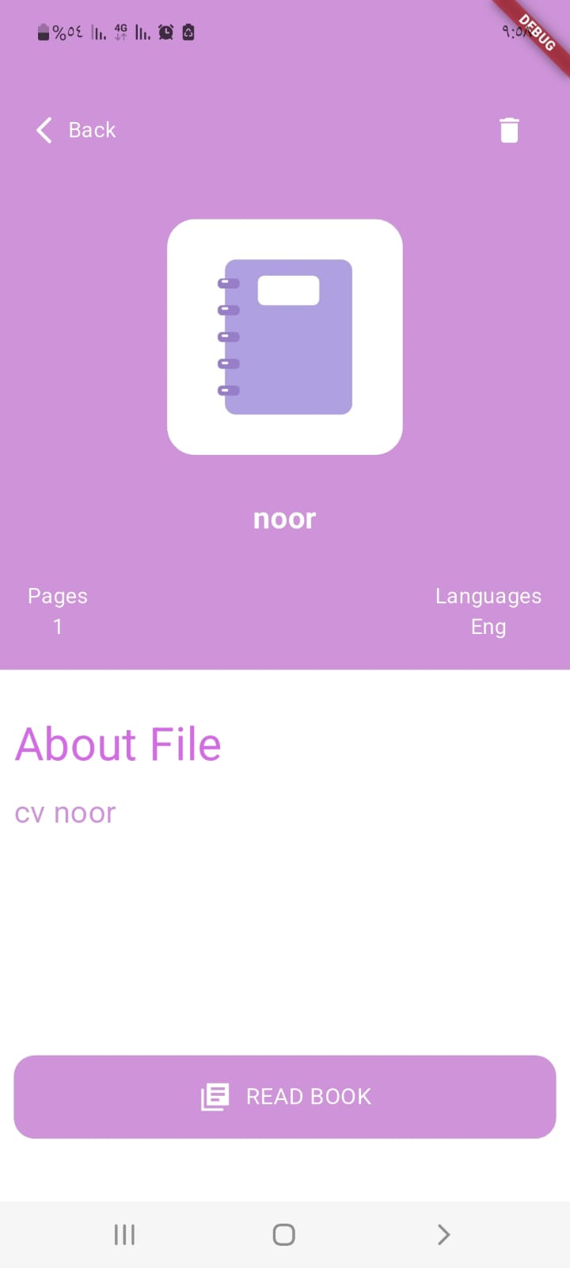
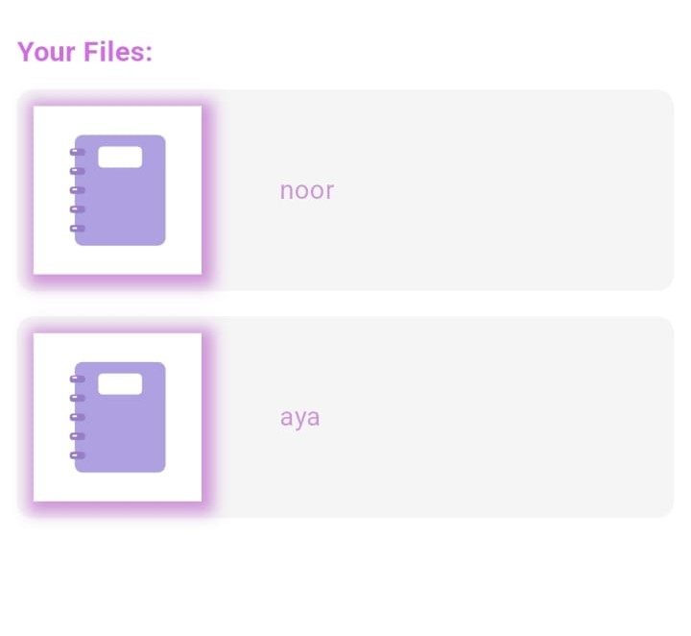
if click this icon , you can delete this file
Title file
if click the file appear this screen
If click this button open this file and can read this and more actions

Slide 9
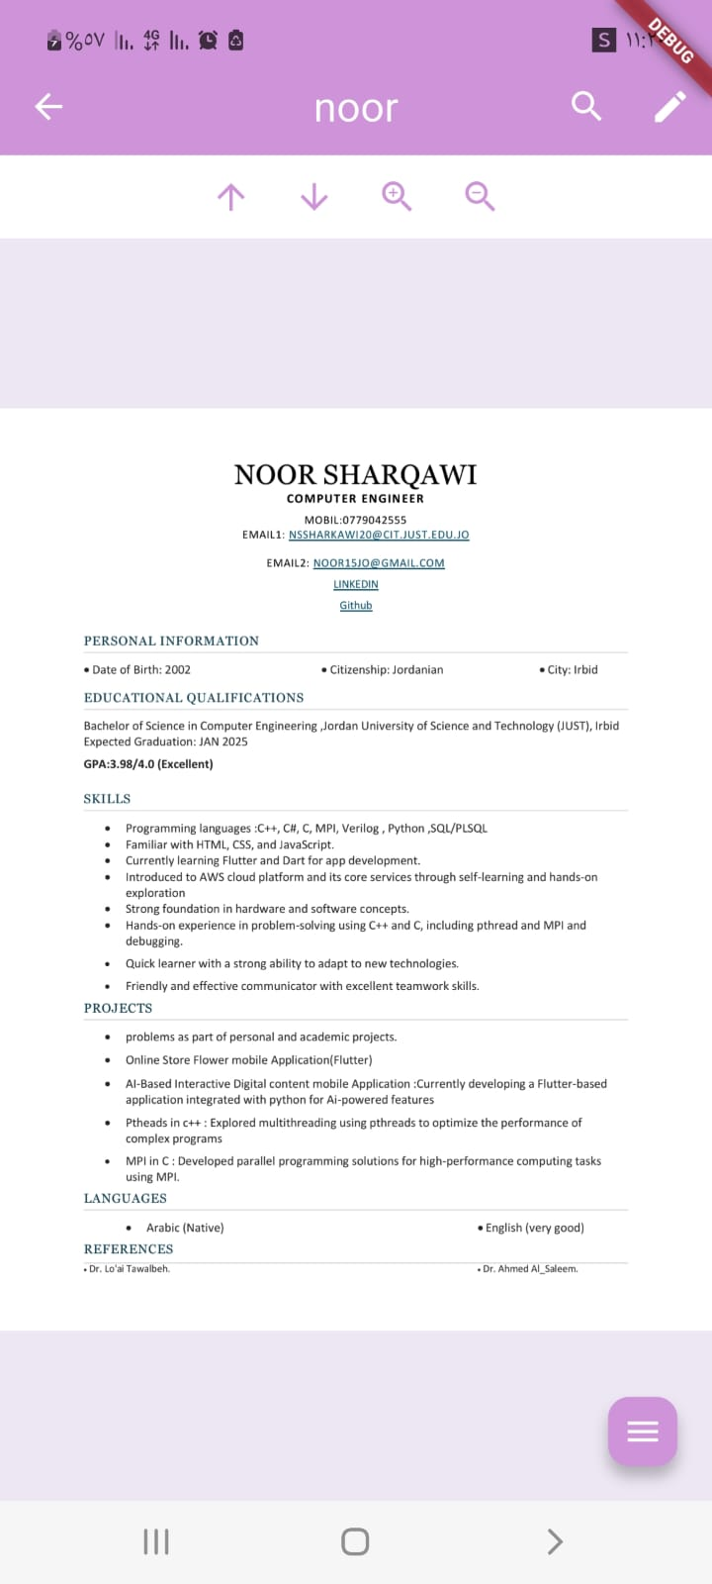
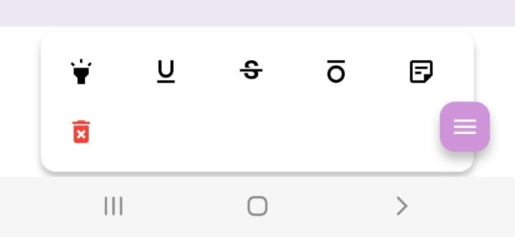
This file page :
user can search any text in this file
Next page and previous page
Zoom in and zoom out
to add annotation in pdf file such as (Highlight, Underline, Strikethrough, Squiggly, Sticky Note)

Slide 10
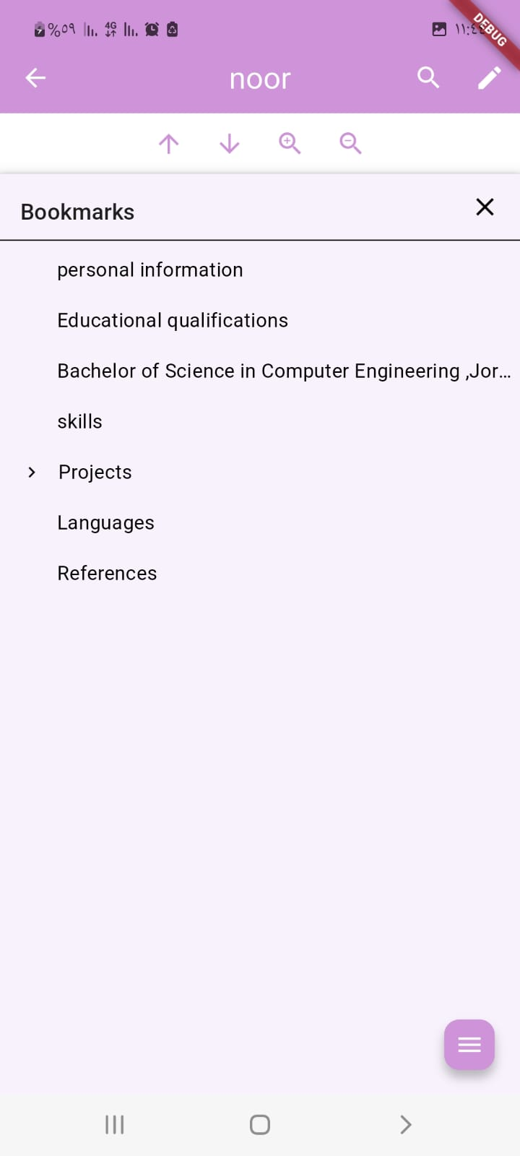
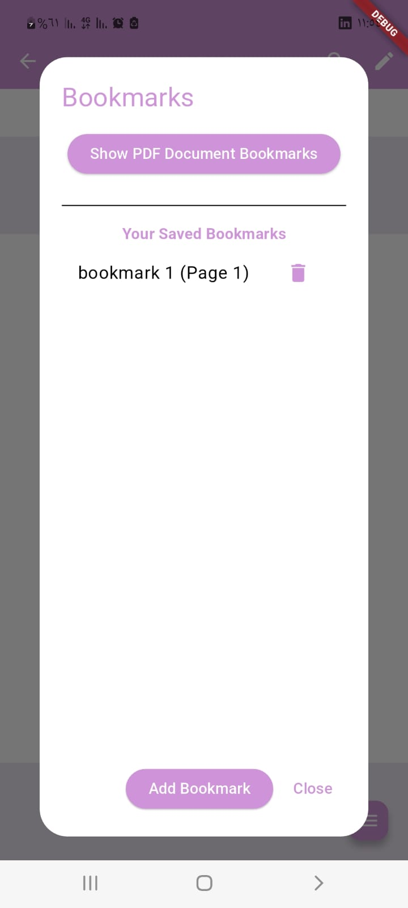

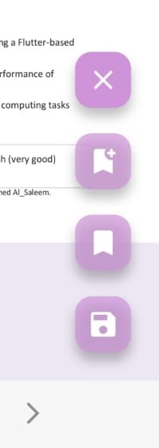
Bookmark :
if file already content bookmark
if user need to delete bookmark
all bookmarks add from user
if user need to add bookmark

Slide 11
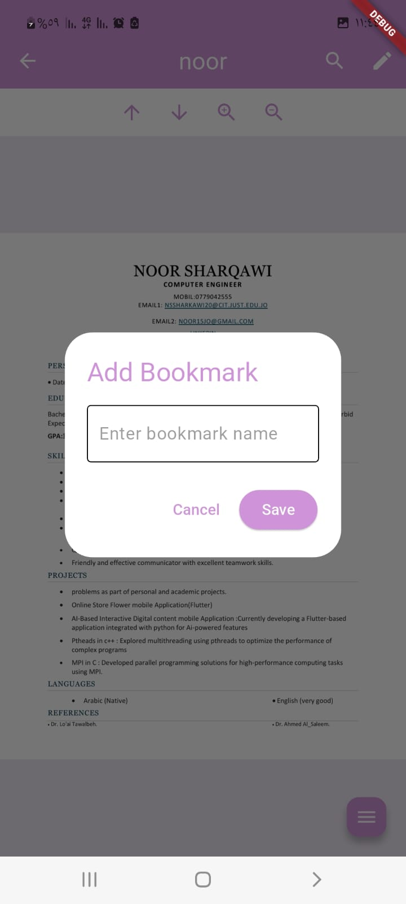
Bookmark :
if user need to add bookmark
if user want save position reading in this file

Slide 12
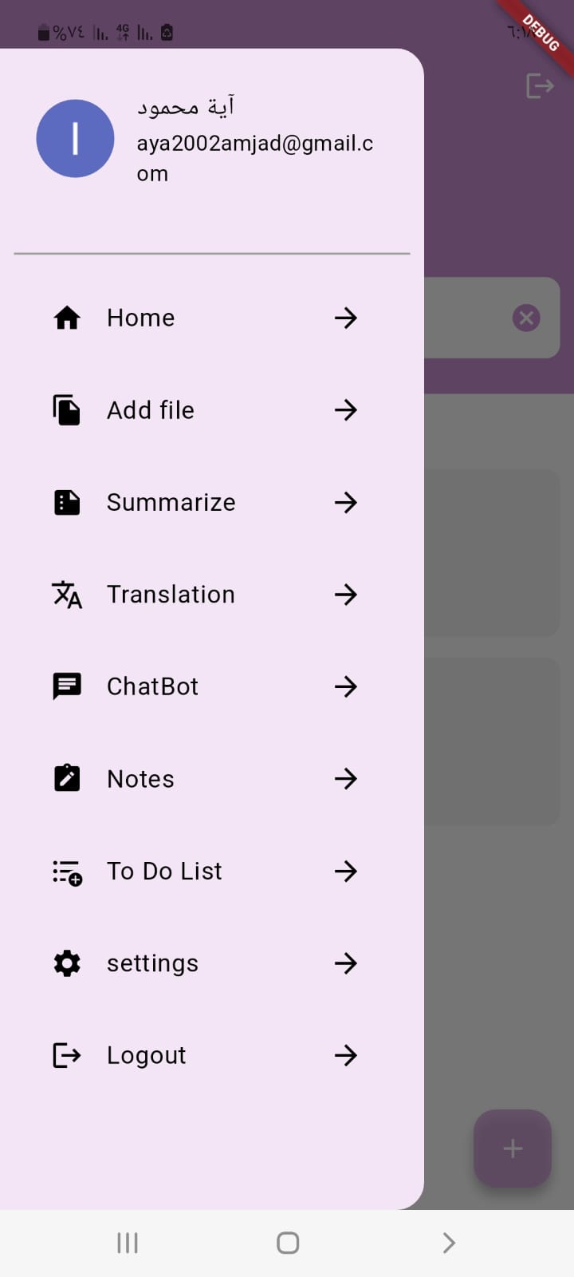
This Drawer

Slide 13
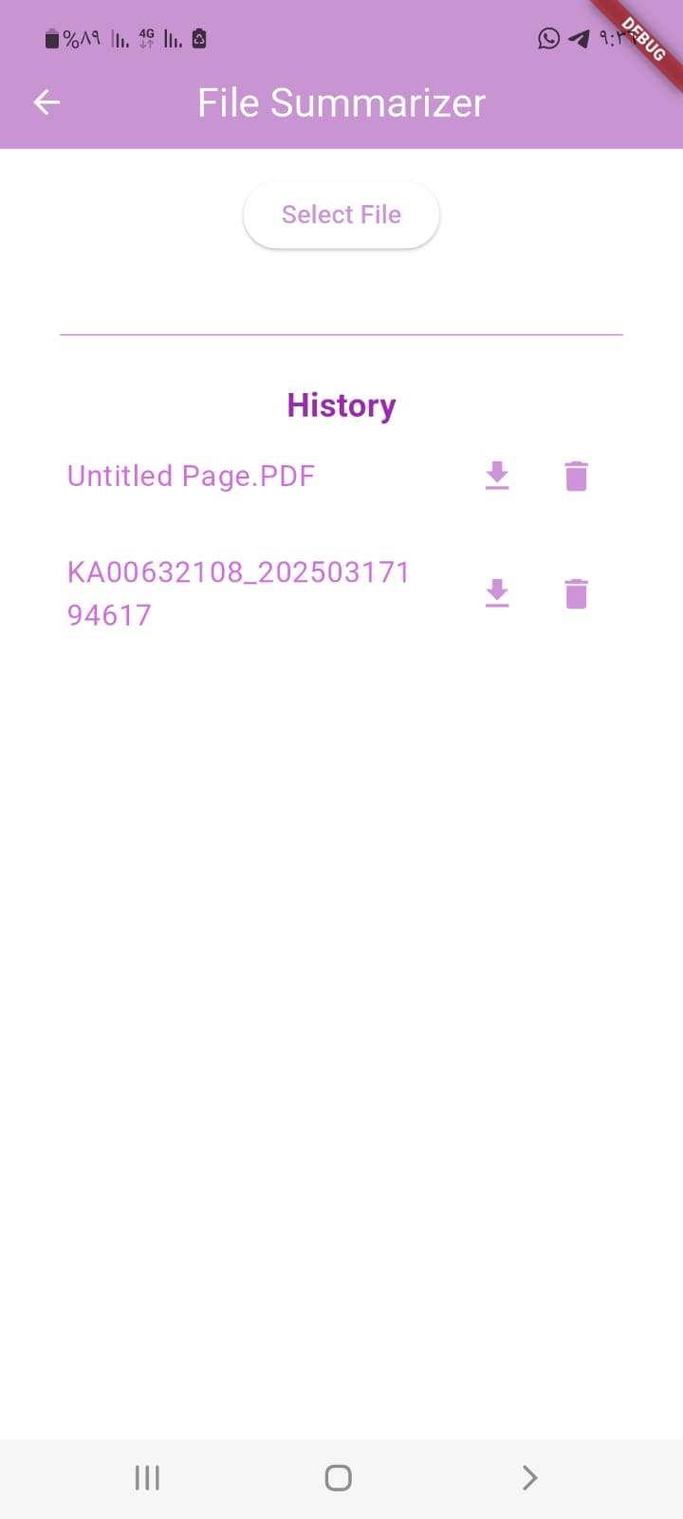
Summarize
select file your want summarize it
download file to your device
summarized files
delete file

Slide 14
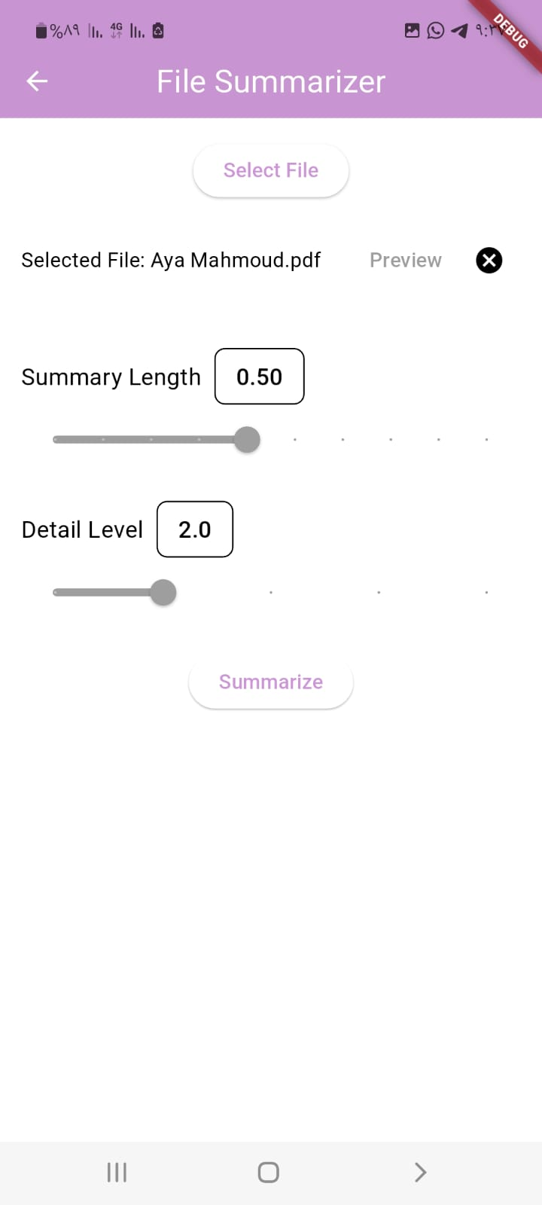
Screen after select file
Cancel
The user can control the summary length
The user can control the detail
Start summarize

Slide 15
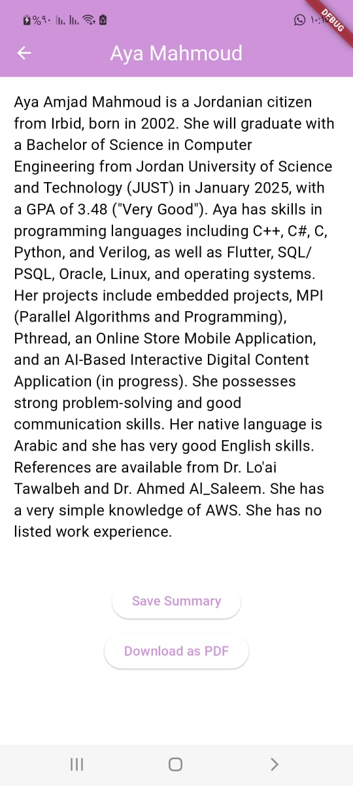
After click button summarize
Save file then save show this file in history
download file to your device

Slide 16
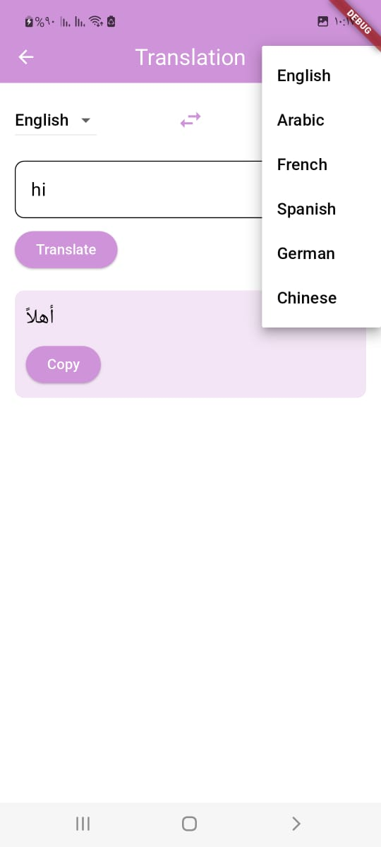
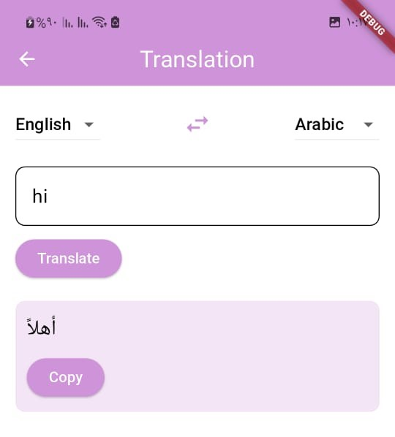
Translation
Swap between
language
Available translation
languages
Can copy text by select
or using button copy

Slide 17
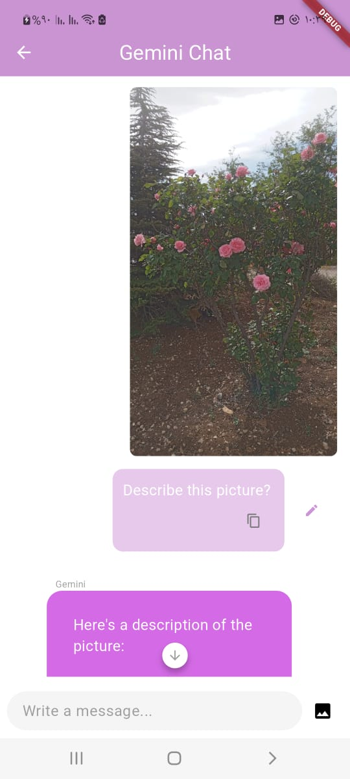
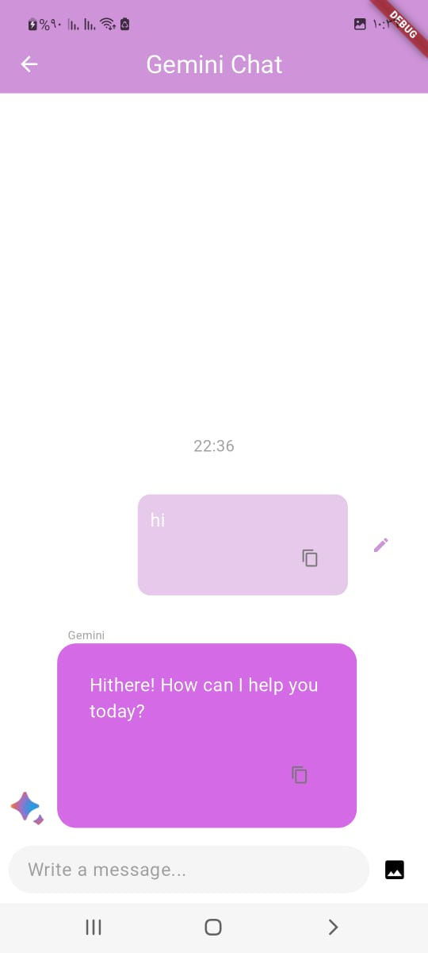
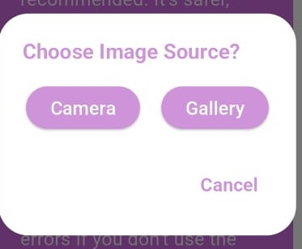
ChatBot
Can edit text
and send again
Can copy text
You can choose
image source
Can send image

Slide 18
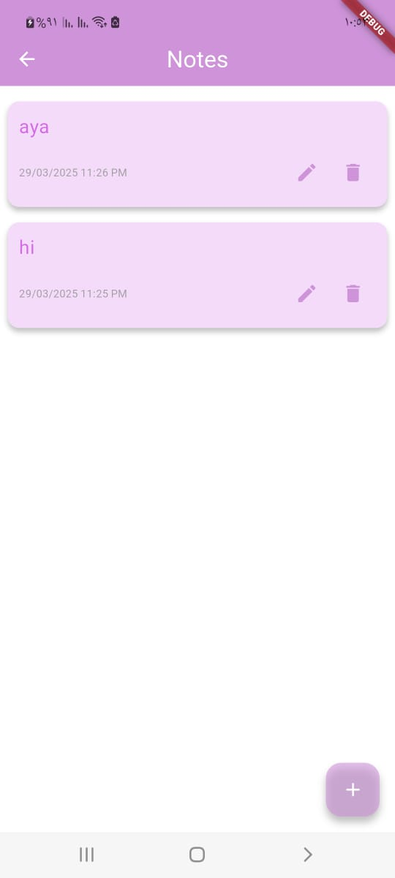
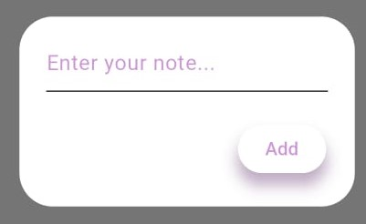
Notes
Edit note
Add note
Delete note

Slide 19
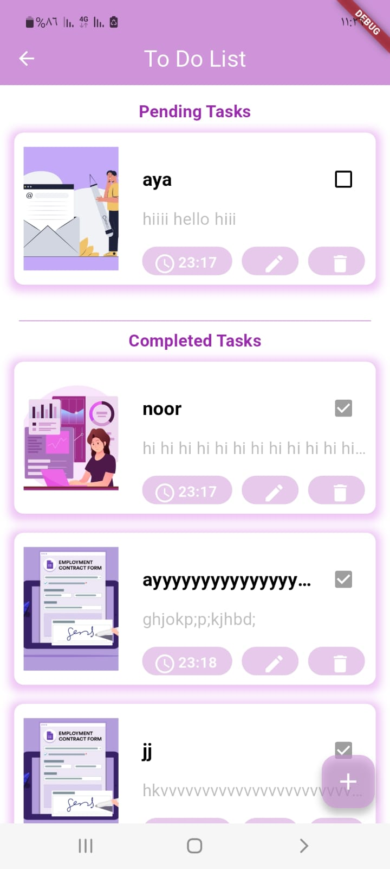
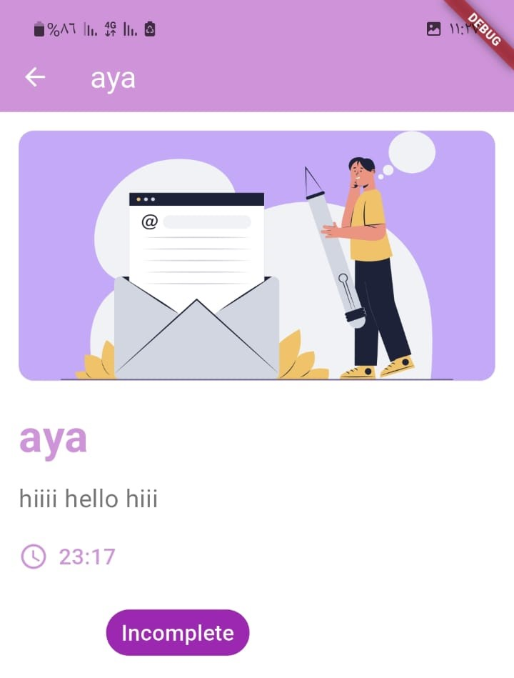
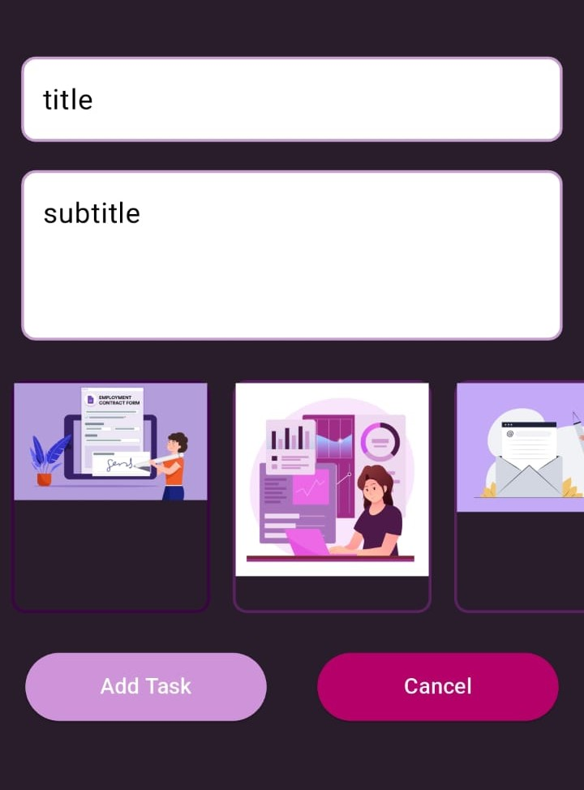
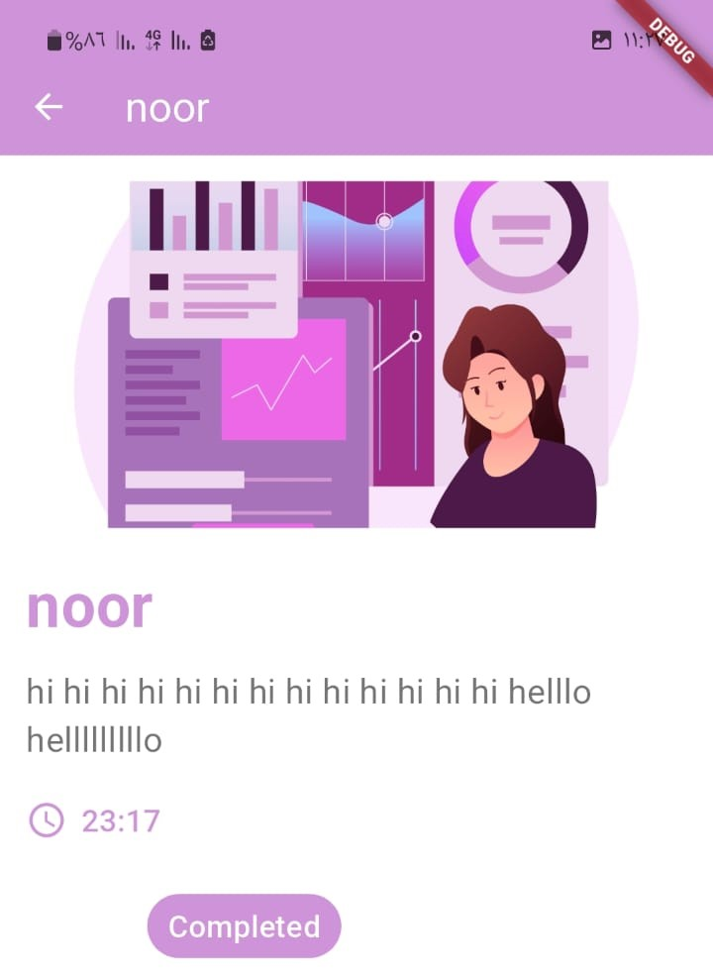
To Do List
Time span
Edit task
Delete task
add task

Slide 20
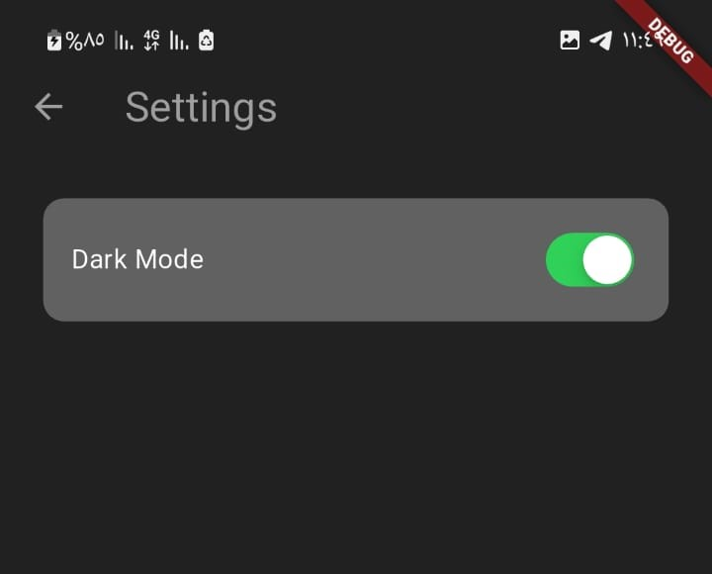
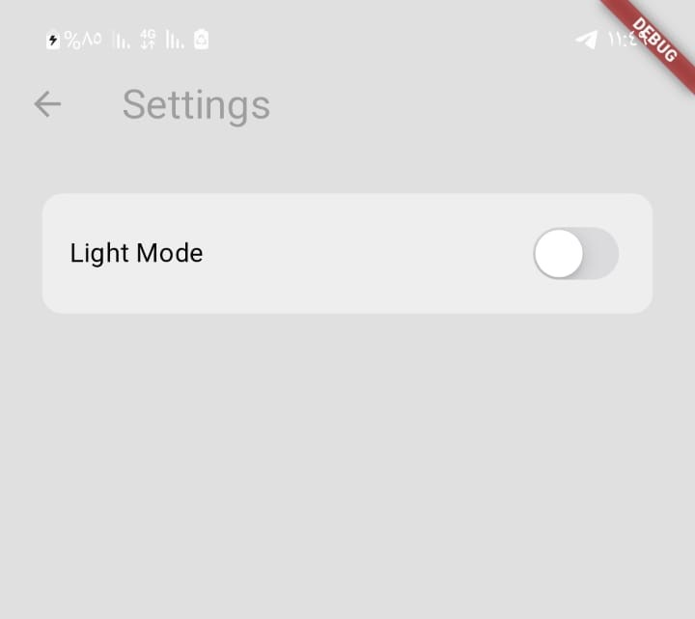
Setting

